Slide 1
HOTEL RESERVATION ANALYSIS WITH SQL

Slide 2
OVERVIEW
The hotel industry relies on data to make informed decisions and provide a better guest experience.
In this project, I will work with a hotel reservation dataset to gain insights into guest preferences , booking trends, and other key factors that impact the hotel's operations.
I will use SQL to query and analyze the data, as well as answer specific questions about the dataset.

Slide 3
About Dataset
booking_ID: A unique identifier for each hotel reservation.
no_of_adults: The number of adults in the reservation.
no_of_children: The number of children in the reservation.
no_of_weekend_nights: The number of nights in the reservation that fall on weekends.
no_of_week_nights: The number of nights in the reservation that fall on weekdays.
type_of_meal_plan: The meal plan chosen by the guests.
room_type_reserved: The type of room reserved by the guests.
lead_time: The number of days between booking and arrival.
arrival_date: The date of arrival.
market_segment_type: The market segment to which the reservation belongs.
avg_price_per_room: The average price per room in the reservation.
booking_status: The status of the booking.

Slide 4
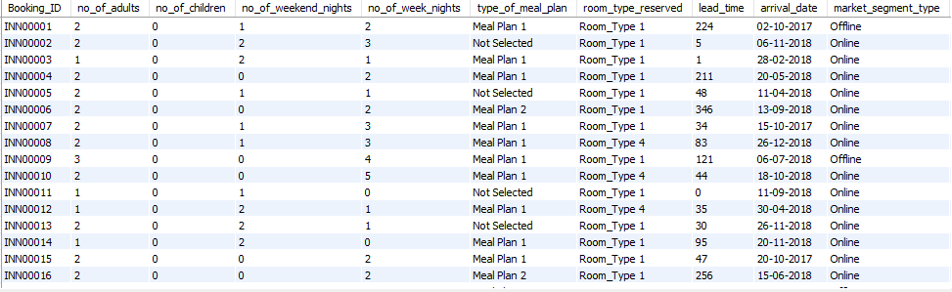
Hotel Reservation dataset

Slide 5

Query 1. What is the total number of reservations in the dataset?
Query
Result

Slide 6


Query 2. Which meal plan is the most popular among guests?
Query
Result

Slide 7


Query 3. What is the average price per room for reservations involving children?
Query
Result

Slide 8


Query 4. How many reservations were made for the year 20xx (replace XX with the desired year)?
Query
Result

Slide 9


Query 5. What is the most commonly booked room type?
Query
Result

Slide 10


Query 6. How many reservations fall on a weekend (no_of_weekend_nights > 0)?
Query
Result

Slide 11


Query 7. What is the highest and lowest lead time for reservations?
Query
Result

Slide 12
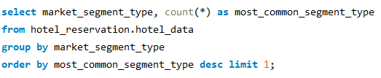

Query 8. What is the most common market segment type for reservations?
Query
Result

Slide 13


Query 9. How many reservations have a booking status of "Confirmed"?
Query
Result

Slide 14


Query 10. What is the total number of adults and children across all reservations?
Query
Result

Slide 15


Query 11. What is the average number of weekend nights for reservations involving children?
Query
Result

Slide 16

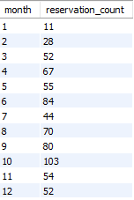
Query 12. How many reservations were made in each month of the year?
Query
Result

Slide 17
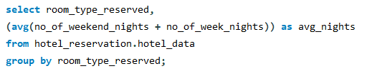
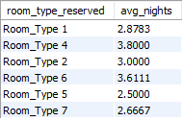
Query 13. What is the average number of nights (both weekend and weekday) spent by guests for each room type?
Query
Result

Slide 18
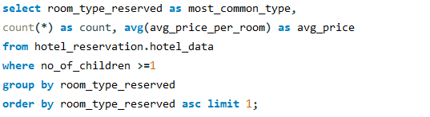

Query 14. For reservations involving children, what is the most common room type, and what is the average price for that room type?
Query
Result

Slide 19
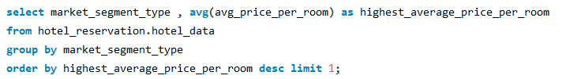

Query 15. Find the market segment type that generates the highest average price per room.
Query
Result

Slide 20
Thank you

